Slide 1
Unit 2
Classical Encryption Techniques
By Purvi Tandel
Uka Tarsadia University

Slide 2
Outline
  Symmetric Cipher Model
  Substitution Techniques
  Transposition Techniques
Notes:
X.800 and RFC 2828
International Telecommunication Union (ITU)

Slide 3
Encryption and Decryption
Sender
Hello
Encryption
f7#er
Decryption
Hello
Receiver

Slide 4




Symmetric Cipher Model (Conventional Encryption)
Secret key shared by sender and recipient
Secret key shared by sender and recipient
K
K
Transmitted
cipher text
Y = E(K, X)
X
X
Plaintext
input
Encryption Algorithm
(e.g. AES)
Decryption Algorithm
(reverse of encryption algorithm)
Plaintext
output
Plaintext is the original intelligible message or data that is fed into the algorithm as input.
Encryption algorithm performs various substitutions and transformations on the plaintext.
The secret key is also input to the encryption algorithm.
The key is a value independent of the plaintext and of the algorithm.
The algorithm will produce a different output depending on the specific key being used at the time.
Decryption algorithm is essentially the encryption algorithm run in reverse.
It takes the ciphertext and the secret key and produces the original plaintext.
Ciphertext is the scrambled message produced as output.
It depends on the plaintext and the secret key.
The ciphertext is an apparently random stream of data and, as it stands, is unintelligible.
An original message is known as the plaintext, while the coded message is called the ciphertext.
The process of converting from plaintext to ciphertext is known as enciphering or encryption; restoring the plaintext from the ciphertext is deciphering or decryption.

Slide 5
Terminology
Plaintext: original message
Ciphertext: encrypted or coded message
Encryption: convert from plaintext to ciphertext (enciphering)
Decryption: restore the plaintext from ciphertext (deciphering)
Key: information used in cipher known only to sender/receiver
Cipher: a particular algorithm (cryptographic system)
Cryptography: study of algorithms used for encryption
Cryptanalysis: study of techniques used for decryption without knowledge of plaintext
Cryptology: areas of cryptography and cryptanalysis

Slide 6
Cryptography and Cryptanalysis
Cryptography(Secret Writing) is the process of protecting information by transforming it into a secure (unreadable) format.
Cryptanalysis is the decryption and analysis of encrypted text. Cryptanalysis uses mathematical formulas to search algorithm vulnerabilities and break into cryptography.
Hello
Cryptography
$!dzx
$!dzx
Cryptanalysis
Hello
Notes:
either "writing" or a "field of study"
Calligraphy
Geography
cinematography
autobiography

Slide 7
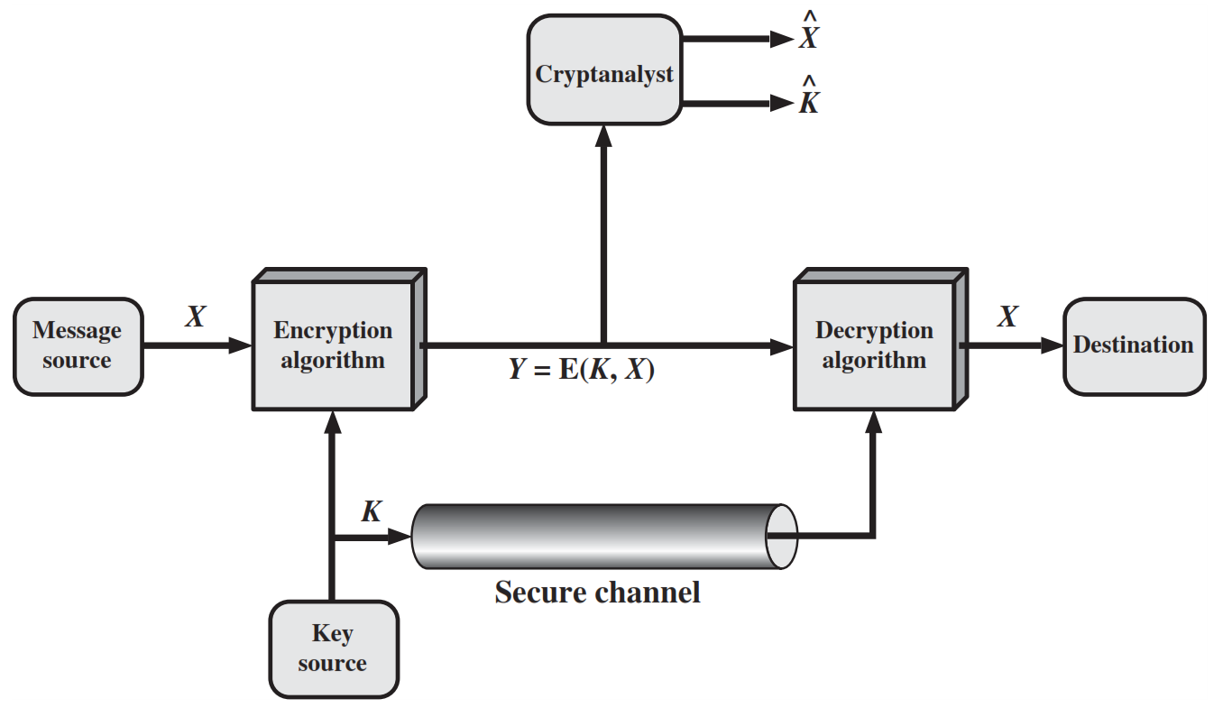
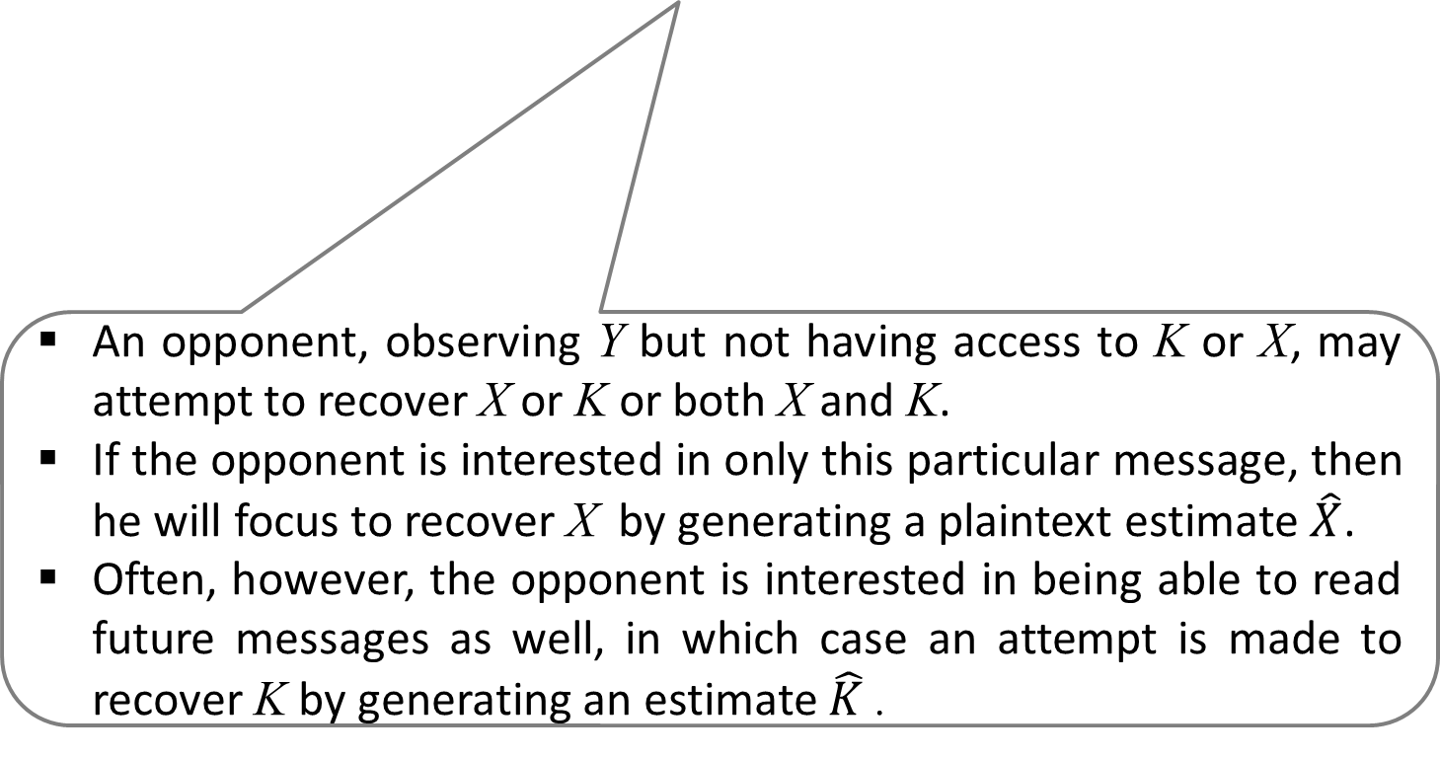
An opponent, observing Y but not having access to K or X, may attempt to recover X or K or both X and K.
If the opponent is interested in only this particular message, then he will focus to recover X by generating a plaintext estimate $\hat{X}$.
Often, however, the opponent is interested in being able to read future messages as well, in which case an attempt is made to recover K by generating an estimate $\hat{K}$.

Slide 8
Requirements and Assumptions
Requirements for secure use of symmetric encryption:
Strong encryption algorithm: Given the algorithm and cipher text, an attacker cannot obtain key or plaintext.
Shared secret keys: sender and receiver both have shared a secret key; no-one else knows the key(keep it secret).
Assumptions:
Cipher is known
Secure channel to distribute keys

Slide 9
Cryptanalysis and Brute-Force Attack
Objective of attacker: recover key (not just message)
Approaches of attacker:
Cryptanalysis: This type of attack exploits the characteristics of the algorithm to attempt to derive a specific plaintext or to derive the key being used.
Brute-force attack: The attacker tries every possible key on a piece of ciphertext until an intelligible translation into plaintext is obtained.
On average, half of all possible keys must be tried to achieve success.

Slide 10
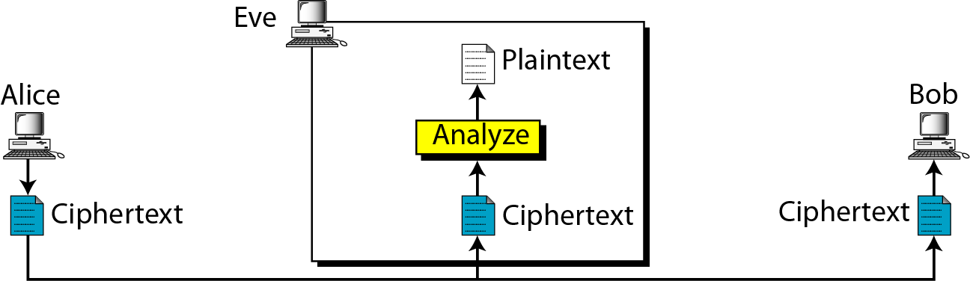
Attacks on Encrypted Messages
Type of Attack | Known to cryptanalyst
Ciphertext Only | Encryption algorithm, Ciphertext

Slide 11
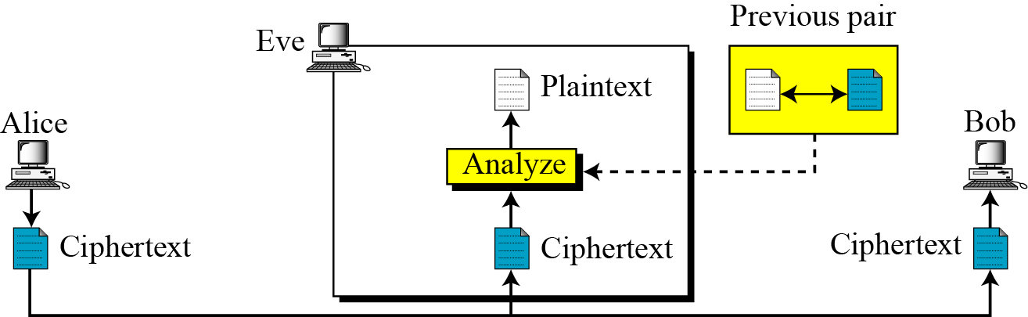
Attacks on Encrypted Messages
Type of Attack | Known to cryptanalyst
Known Plaintext | Encryption algorithm, Ciphertext, One or more plaintext-cipher text pairs formed with the secret key

Slide 12
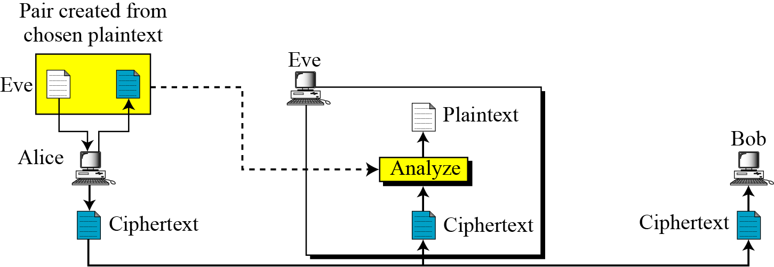
Attacks on Encrypted Messages
Type of Attack | Known to cryptanalyst
Chosen Plaintext | Encryption algorithm, Ciphertext, Plaintext message chosen by cryptanalyst

Slide 13
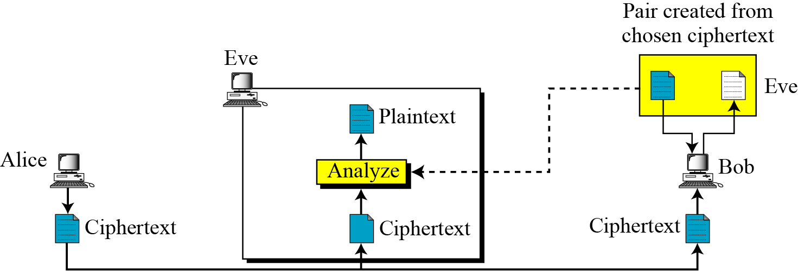
Attacks on Encrypted Messages
Type of Attack | Known to cryptanalyst
Chosen Ciphertext | Encryption algorithm, Ciphertext, Ciphertext chosen by cryptanalyst, with its corresponding decrypted plaintext generated with the secret key

Slide 14
Attacks on Encrypted Messages
Type of Attack | Known to cryptanalyst
Chosen text | Encryption algorithm, Ciphertext, Plaintext chosen by cryptanalyst, with its corresponding ciphertext generated with the secret key , Ciphertext chosen by cryptanalyst, with its corresponding decrypted plaintext generated with the secret key

Slide 15
There is no encryption algorithm that is unconditionally secure.
Therefore, all that the users of an encryption algorithm can strive for is an algorithm that meets one or both of the following criteria:
1. The cost of breaking the cipher exceeds the value of the encrypted information.
2. The time required to break the cipher exceeds the useful lifetime of the information.
An encryption scheme is said to be computationally secure if either of the foregoing two criteria are met. The rub is that it is very difficult to estimate the amount of effort required to cryptanalyse ciphertext successfully.

Slide 16
Classical Encryption Techniques
Classified in two categories:
Substitution Techniques
[Letters are replaced by other letters]
  Caesar Cipher
  Monoalphabetic Cipher
  Playfair Cipher
  Hill Cipher
  Polyalphabetic Ciphers
  One-Time Pad
Transposition Techniques
[Letters are rearranged]
  1. Rail Fence
  2. Columnar

Slide 17
Substitution Techniques
A substitution technique is one in which the letters of plaintext are replaced by other letters or by numbers or symbols.
If plaintext viewed as sequence of bits, replace plaintext bit patterns with ciphertext bit patterns.
  Caesar Cipher
  Monoalphabetic Cipher
  Playfair Cipher
  Hill Cipher
  Polyalphabetic Ciphers
  One-Time Pad

Slide 18
Caesar Cipher
The Caesar Cipher involves replacing each letter of the alphabet with the letter standing three places further down the alphabet.
For encryption algorithm is:
For decryption algorithm is:
C = E(3, P) = (P + 3) mod 26
P = D(3, C) = (C - 3) mod 26

Slide 19
Caesar Cipher (Cont…)
Let us assign a numerical equivalent to each letter
a | b | c | d | e | f | g | h | i | j | k | l | m
0 | 1 | 2 | 3 | 4 | 5 | 6 | 7 | 8 | 9 | 10 | 11 | 12
n | o | p | q | r | s | t | u | v | w | x | y | z
13 | 14 | 15 | 16 | 17 | 18 | 19 | 20 | 21 | 22 | 23 | 24 | 25
C = E(3, P) = (P + 3) mod 26
Plain: a b c d e f g h i j k l m n o p q r s t u v w x y z
Cipher: d e f g h i j k l m n o p q r s t u v w x y z a b c
Example:
Plaintext: THE QUICK BROWN FOX
Ciphertext: WKH TXLFN EURZQ IRA

Slide 20
Caesar Cipher (Cont…)
Generalised Caesar Cipher
    Allow shift by k positions.
    Encryption :
    Decryption :
Modulo for negative number is = N- (B%N)
Example :
-11 mod 26 = 15
26-(11%26) = 15
C = E(K, P) = (P + K) mod 26
P = D(K, C) = (C - K) mod 26

Slide 21

Caesar Cipher Examples
Plaintext: networksecurity
Key: 7
Cipher:
Cipher: exxegoexsrgi
Key: 4
Plaintext :
uladvyrzljbypaf
attackatonce
Cipher: kyzj dvjjrxv zj vetipgkvu
Key: 17
Plain:
Plain: information security
Key: l
Cipher:
this message is encrypted
tyqzcxletzy dpnfctej

Slide 22
Brute force attack on Caesar Cipher
The encryption and decryption algorithms are known.
There are only 25 keys to try, e.g. k=1, k=2, …
The language of the plaintext is known and easily recognizable.

Slide 23
Brute force attack on Caesar Cipher
Ciphertext: ZNK WAOIQ HXUCT LUD
Key | Transformed text
1 | YMJ VZNHP GWTBS KTC
2 | XLI UYMGO FVSAR JSB
3 | WKH TXLFN EURZQ IRA
4 | VJG SWKEM DTQYP HQZ
5 | UIF RVJDL CSPXOGPY
6 | THE QUICK BROWN FOX
7 | SGD PTHBJ AQNVM ENW
8 | RFC OSGAI ZPMUL DMV
9 | QEB NRFZH YOLTK CLU
10 | PDA MQEYG XNKSJ BKT
11 | OCZ LPDXF WMJRI AJS
12 | NBY KOCWE VLIQH ZIR
13 | MAX JNBVD UKHPG YHQ
Key | Transformed text
14 | LZW IMAUC TJGOF XGP
15 | KYV HLZTB SIFNE WFO
16 | JXU GKYSA RHEMD VEN
17 | IWT FJXRZ QGDLC UDM
18 | HVS EIWQY PFCKB TCL
19 | GUR DHVPX OEBJA SBK
20 | FTQ CGUOW NDAIZ RAJ
21 | ESP BFTNV MCZHY QZI
22 | DRO AESMU LBYGX PYH
23 | CQN ZDRLT KAXFW OXG
24 | BPM YCQKS JZWEV NWF
25 | AOL XBPJR IYVDU MVE

Slide 24
Substitution Techniques
  Caesar Cipher
  Monoalphabetic Cipher
  Playfair Cipher
  Hill Cipher
  Polyalphabetic Ciphers
  One-Time Pad

Slide 25
2. Monoalphabetic Cipher (Simple substitution)
It is an improvement to the Caesar Cipher.
Instead of shifting the alphabets by some number, this scheme uses some permutation of the letters in alphabet.
Use a single alphabet for both plaintext and cipher text.
Example:
Cipher: kxlvzofemrj
Plaintext:
Try Brute force attack :
  With 26 letters in alphabet, the possible permutations are 26! Keys (>4x10²⁶)
Plain: a b c d e f g h i j k l m n o p q r s t u v w x y z
Cipher: y n l k x b s h m i w d p j r o q v f e a u g t z c
decrypstion

Slide 26
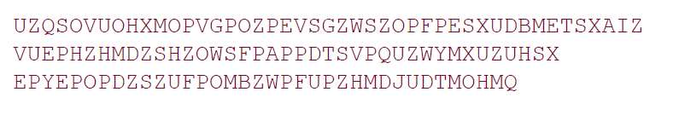
2. Monoalphabetic Cipher (Simple substitution)
As a first step, the relative frequency of the letters can be determined and compared to a standard frequency distribution for English,

Slide 27
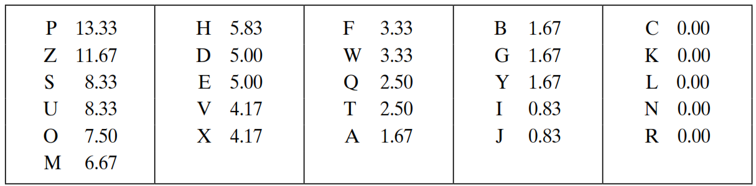
Attack on Monoalphabetic Cipher
The relative frequencies of the letters in the ciphertext (in %) are
Ciphertext:
uzqsovuohxmopvgpozpevsgzwszopfpesxudbmetsxaizvuephzhmdzshzowsfpappdtsvpquzwymxuzuhsxepyepopdzszufpombzwpfupzhmdjudtmohmq
In our ciphertext, the most common digram is ZW, which appears three times. So equate Z with t, W with h and P with e.
Now notice that the sequence ZWP appears in the ciphertext, and we can translate that sequence as “the.”

Slide 28
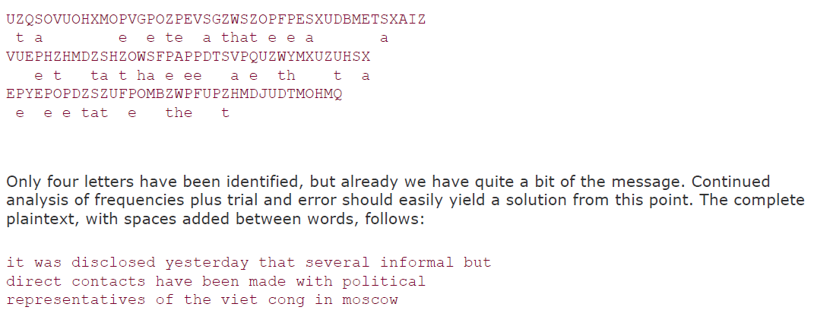
Attack on Monoalphabetic Cipher

Slide 29
Attack on Monoalphabetic Cipher (Cont…)
If the cryptanalyst knows the nature of the plaintext, then the analyst can exploit the regularities of the language.
The relative frequency of the letters can be determined and compared to a standard frequency distribution for English.
If the message were long enough, this technique alone might be sufficient, but because this is a relatively short message, we cannot expect an exact match.

Slide 30
Substitution Techniques
  Caesar Cipher
  Monoalphabetic Cipher
  Playfair Cipher
  Hill Cipher
  Polyalphabetic Ciphers
  One-Time Pad

Slide 31
Playfair Cipher
The Playfair algorithm is based on a 5 × 5 matrix (key) of letters.
The matrix is constructed by filling in the letters of the keyword (minus duplicates) from left to right and from top to bottom, and then filling in the remainder of the matrix with the remaining letters in alphabetic order. The letters I and J count as one letter.
O | C | U | R | E
N | A | B | D | F
G | H | I/J | K | L
M | P | Q | S | T
V | W | X | Y | Z
Example:
Keyword= OCCURRENCE
Plaintext= TALL TREES

Slide 32
Playfair Cipher - Encrypt Plaintext
Operate on pair of letters (digram) at a time.
Special: if digram with same letters appears, separate by special letter (e.g. x)
If there is an odd number of letters, then add uncommon letter to complete digram, a X/Z may be added to the last letter.
  Plaintext= NETWORK
  Plaintext= NE TW OR KX
Plaintext= TALL TREES
Plaintext= TA LX LT RE ES

Slide 33
Playfair Cipher - Encrypt Plaintext
Plaintext: TA LX LT RE ES
O | C | U | R | E
N | A | B | D | F
G | H | I/J | K | L
M | P | Q | S | T
V | W | X | Y | Z
Map each pair in key matrix
Ciphertext: PF IZ TZ EO RT
If the letters are on different rows and columns, replace them with the letters on other corner of the same row.
The order is important - the first letter of the pair should be replaced first.
For example, using the table above, the letter pair TA would be encoded as PF.
If the letters appear on the same row, replace them with the letters to their immediate right respectively, wrapping around to the left side of the row if necessary.
For example, using the table above, the letter pair RE would be encoded as EO.
If the letters appear on the same column, replace them with the letters immediately below, wrapping around to the top if necessary.
For example, using the table above, the letter pair LT would be encoded as TZ.

Slide 34
Playfair Cipher - Is it Breakable?
Better than monoalphabetic: relative frequency of digrams much less than of individual letters.
But relatively easy (digrams, trigrams, expected words)

Slide 35
Playfair Cipher Examples
Key= “engineering ” Plaintext= “test this process ”
Key= “keyword ” Plaintext= “come to the window”
Key= “moonmission ” Plaintext= “greet ”
E N G I R A B C D F H K L M O P Q S T U V W X Y Z | Encrypted Message: pi tu pm gt ue lf gp xg
K E Y W O R D A B C F G H I L M N P Q S T U V X Z | Encrypted Message: Lc nk zk vf yo gq ce bw
M O N I S A B C D E F G H K L P Q R T U V W X Y Z | Encrypted Message: hq cz du

Slide 36
Playfair Cipher Examples
Key: EXAMPLE
Ciphertext: UA ARBED EXAPO PR QNX AXANR
Pair: UA AR BE DE XA PO PR QN XA XA NR
Plaintext: we wi lx lm ex et at th ex ex it
Plaintext: we wilxl mexet at thex exit
Plaintext: we will meet at the exit
E | X | A | M | P
L | B | C | D | F
G | H | I/J | K | N
O | Q | R | S | T
U | V | W | Y | Z

Slide 37
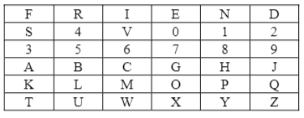
Playfair Cipher 6*6 Matrix Examples
Keyword: FRIENDS4EVER
Key: FRIENDS4V
Rules :
Enter the secret (password) which may contain numerals and alphabets.
Find out the keyword by dropping the duplicate letters of key.
Arrange the keyword in 6 X 6 matrix row-wise: left to right and then top-to-bottom.
Fill the remaining spaces in the matrix with the rest of numerals (0-9) and alphabets (A-Z) that were not the part of our keyword.

Slide 38
Playfair Cipher Encryption rules
Rules :
If both the letters are in same row then a[i][j] = a[i+1][j]
If both the letters are in same column then a[i][j] = a[i][j+1]
If both the letters are not in same row or column(diagonal position) then
a[row1][col1] = a[row1][col2]
a[row2][col2] = a[row2][col1]

Slide 39
Playfair Examples - Encryption
Keyword: FRIENDS4EVER
Plaintext : GJ19 AA 1111
Step 1: Remove the repeating elements from given key
Key1: FRIENDS4V
Step 2: Prepare Key matrix (Diagram)

Slide 40
Playfair Examples - Encryption
Keyword: FRIENDS4EVER
Plaintext : GJ19 AA 1111
Step 3: Prepare the pair of plaintext by adding dummy x if letters are repeating in a pair
Plaintext1: GJ 19 AX A1 1X 1X 1X
Step 4: Encryption using 3 rules of encryption.
Plaintext1 : GJ 19 AX A1 1X 1X 1X
Ciphertext : HA 28 GT HS 0Y 0Y 0Y

Slide 41
Playfair Examples - Decryption
Keyword: FRIENDS4EVER
Ciphertext : HA28GTHS0Y0Y0Y
Step 1: Remove the repeating elements from given key
Key1: FRIENDS4V
Step 2: Prepare Key matrix (Diagram)

Slide 42
Playfair Examples - Decryption
Keyword: FRIENDS4EVER
Ciphertext : HA28GTHS0Y0Y0Y
Step 3: Prepare the pair of ciphertext by adding dummy x if letters are repeating in a pair
ciphertext1: HA 28 GT HS 0Y 0Y 0Y
Step 4: Decryption using 3 rules of Decryption.
Ciphertext : HA 28 GT HS 0Y 0Y 0Y
Plaintext1 : GJ 19 AX A1 1X 1X 1X

Slide 43
Substitution Techniques
  Caesar Cipher
  Monoalphabetic Cipher
  Playfair Cipher
  Hill Cipher
  Polyalphabetic Ciphers
  One-Time Pad

Slide 44
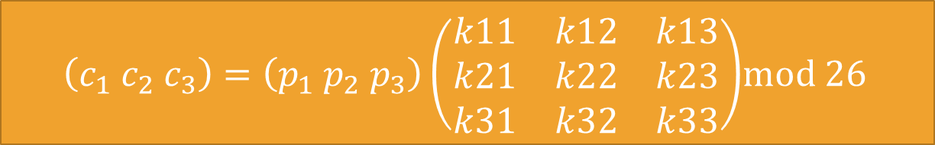
Hill Cipher
Hill cipher is based on linear algebra
Each letter is represented by numbers from 0 to 25 and calculations are done using modulo 26.
Encryption and decryption can be given by the following formula:
  Encryption:
  Decryption:
  C=PK mod 26
  P=CK⁻¹ mod 26
  $\left(c_{1} c_{2} c_{3}\right)=\left(p_{1} p_{2} p_{3}\right)\left(\begin{matrix}k11 & k12 & k13 \\ k21 & k22 & k23 \\ k31 & k32 & k33\end{matrix}\right)$mod 26

Slide 45
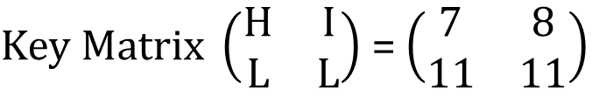
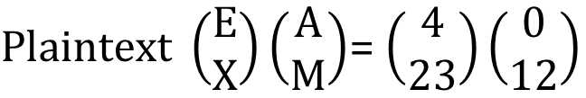
Hill Cipher Encryption
To encrypt a message using the Hill Cipher we must first turn our keyword and plaintext into a matrix (a 2 x 2 matrix or a 3 x 3 matrix, etc).
Example: Key = “HILL”, Plaintext = “EXAM”
a | b | c | d | e | f | g | h | i | j | k | l | m
0 | 1 | 2 | 3 | 4 | 5 | 6 | 7 | 8 | 9 | 10 | 11 | 12
n | o | p | q | r | s | t | u | v | w | x | y | z
13 | 14 | 15 | 16 | 17 | 18 | 19 | 20 | 21 | 22 | 23 | 24 | 25
$Key Matrix \left(\begin{matrix}H & I \\ L & L\end{matrix}\right)$ = $\left(\begin{matrix}7 & 8 \\ 11 & 11\end{matrix}\right)$
$Plaintext \left(\begin{matrix}E \\ X\end{matrix}\right)\left(\begin{matrix}A \\ M\end{matrix}\right)$= $\left(\begin{matrix}4 \\ 23\end{matrix}\right)\left(\begin{matrix}0 \\ 12\end{matrix}\right)$
Notes:
Exam

Slide 46
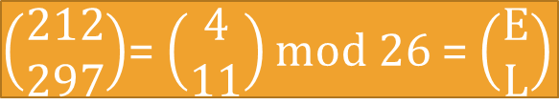
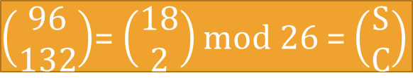
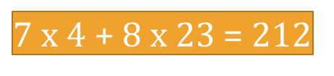
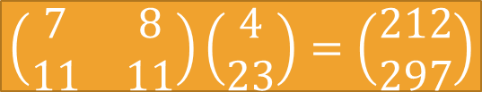
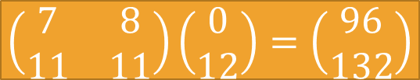
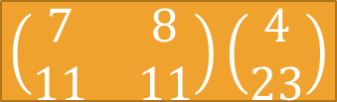
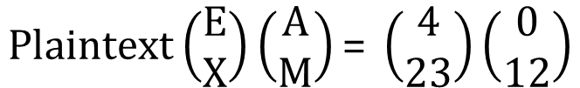
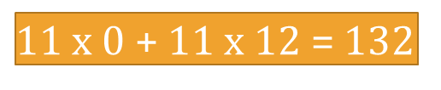
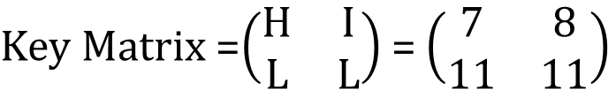
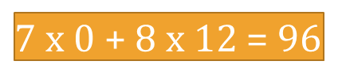
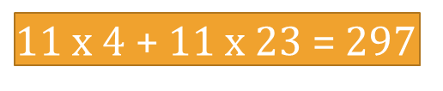
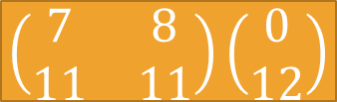
Hill Cipher Encryption (Cont…)
$Key Matrix$=$\left(\begin{matrix}H & I \\ L & L\end{matrix}\right)$ = $\left(\begin{matrix}7 & 8 \\ 11 & 11\end{matrix}\right)$
$$Plaintext\left(\begin{matrix}E \\ X\end{matrix}\right)\left(\begin{matrix}A \\ M\end{matrix}\right)\text{= }\left(\begin{matrix}4 \\ 23\end{matrix}\right)\left(\begin{matrix}0 \\ 12\end{matrix}\right)$$
  C=PK mod 26
$$\left(\begin{matrix}7 & 8 \\ 11 & 11\end{matrix}\right)\left(\begin{matrix}4 \\ 23\end{matrix}\right)$$
$$\left(\begin{matrix}7 & 8 \\ 11 & 11\end{matrix}\right)\left(\begin{matrix}0 \\ 12\end{matrix}\right)$$
$7$ x 4 + 8 x 23 = 212
$7$ x 0 + 8 x 12 = 96
$11$ x 4 + 11 x 23 = 297
$11$ x 0 + 11 x 12 = 132
$$\left(\begin{matrix}7 & 8 \\ 11 & 11\end{matrix}\right)\left(\begin{matrix}4 \\ 23\end{matrix}\right)=\left(\begin{matrix}212 \\ 297\end{matrix}\right)$$
$$\left(\begin{matrix}7 & 8 \\ 11 & 11\end{matrix}\right)\left(\begin{matrix}0 \\ 12\end{matrix}\right)=\left(\begin{matrix}96 \\ 132\end{matrix}\right)$$
$\left(\begin{matrix}212 \\ 297\end{matrix}\right)$= $\left(\begin{matrix}4 \\ 11\end{matrix}\right)$ mod 26 = $\left(\begin{matrix}E \\ L\end{matrix}\right)$
$\left(\begin{matrix}96 \\ 132\end{matrix}\right)$= $\left(\begin{matrix}18 \\ 2\end{matrix}\right)$ mod 26 = $\left(\begin{matrix}S \\ C\end{matrix}\right)$
Ciphertext = “ELSC”

Slide 47
Hill Cipher Decryption
  P=CK⁻¹ mod 26
Step 1: Find Inverse of key matrix
Step 2: Multiply the Multiplicative Inverse of the Determinant by the Adjoin Matrix
Step 3: Multiply inverse key matrix with ciphertext matrix to obtain plaintext matrix

Slide 48
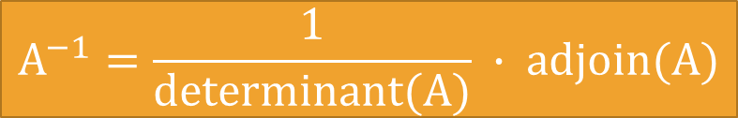
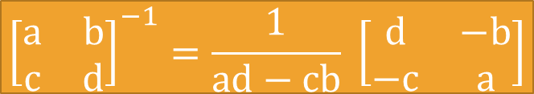
Step 1: Inverse of key matrix
2 X 2 inverse of matrix
$${\left[\begin{matrix}a & b \\ c & d\end{matrix}\right]}^{−1}=\frac{1}{ad−cb} \left[\begin{matrix}d & −b \\ −c & a\end{matrix}\right]$$
3 X 3 inverse of matrix
$$A^{−1}=\frac{1}{determinant(A)} ∙ adjoin(A)$$

Slide 49
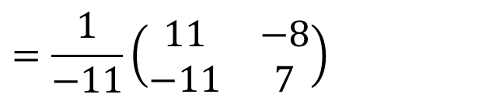
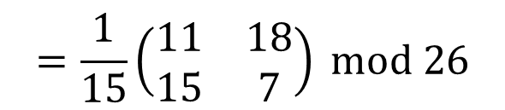
Step 1: Inverse of key matrix
$$Inverse Key Matrix={\left(\begin{matrix}7 & 8 \\ 11 & 11\end{matrix}\right)}^{−1}=\frac{1}{77−88} \left(\begin{matrix}11 & −8 \\ −11 & 7\end{matrix}\right)$$
$$=\frac{1}{−11}\left(\begin{matrix}11 & −8 \\ −11 & 7\end{matrix}\right)$$
-11 mod 26 = 15
Because, modulo for negative number is = N- (B%N)
= 26 – (11%26)
$$=\frac{1}{15}\left(\begin{matrix}11 & 18 \\ 15 & 7\end{matrix}\right) mod 26$$

Slide 50
Step 2: Modular (Multiplicative) inverse
The inverse of a number A is 1/A since A * 1/A = 1
e.g. the inverse of 5 is 1/5
In modular arithmetic we do not have a division operation.
The modular inverse of A (mod C) is A⁻¹
(A * A⁻¹) ≡ 1 (mod C)
Example:
The modular inverse of A mod C is the B value that makes
A * A⁻¹ mod C = 1
  A = 3, C = 11
  Since (3*4) mod 11 = 1, 4 is modulo inverse of 3
  A = 10, C = 17 , A⁻¹ = ?
How?
12

Slide 51
Step 2: Modular (Multiplicative) inverse
  Since (3*4) mod 11 = 1, 4 is modulo inverse of 3
  Euclidean algorithm states that if B=0 then return A as GCD(a, b).
  Extended Euclidean algorithm states that if B=1 then a * a⁻¹ = 1 (mod b)
  GCD (11,3) = ?
  GCD (11,3) = 11 = 3*3 + 2
  3 = 2*1 + 1
  1 = 3 – 2*1 [substitute 2 here]
  1 = 3 – [11 - 3*3]*1
  = 3 – 11 + 3*3
  = 3*4 – 11 [Ignore modulo here]
  4 is a multiplicative inverse of 3 modulo 11.
Here B = 1
Now apply extended Euclidean to find multiplicative inverse of 3 modulo 11

Slide 52
Step 2: Modular (Multiplicative) inverse
  Multiplicative inverse of 15 Modulo 26 is ?
  Extended Euclidean algorithm states that if B=1 then a * a⁻¹ = 1 (mod b)
  GCD (26,15) = ?
  GCD (26,15) = 26 = 15*1 + 11
  15 = 11*1 + 4
  11 = 4*2 + 3
  4 = 3*1 + 1
  1 = 4 – 3*1 [substitute 3 here]
  1 = 4 – [11 - 4*2]*1
  = 4 – 11 + 4*2
  = 4*3 – 11 [substitute 4 here]
  = [15 – 11*1]*3 – 11
  = 15*3 – 11*3 – 11
  = 15*3 – 11*4 [substitute 11 here]
  = 15*3 – [26 – 15*1]*4
  = 15*3 – 26*4 + 15*4
  = 15*7 – 26*4 [Ignore modulo term here]
  7 is a multiplicative inverse of 15 modulo 26.
Here B = 1
Now apply extended Euclidean to find multiplicative inverse of 3 modulo 11

Slide 53


Step 2: Modular (Multiplicative) inverse
Determinants’ multiplicative inverse Modulo 26
Determinant | 1 | 3 | 5 | 7 | 9 | 11 | 15 | 17 | 19 | 21 | 23 | 25
Inverse Modulo 26 | 1 | 9 | 21 | 15 | 3 | 19 | 7 | 23 | 11 | 5 | 17 | 25
$$=\frac{1}{15}\left(\begin{matrix}11 & 18 \\ 15 & 7\end{matrix}\right) mod 26$$
Multiplicative inverse of $\frac{1}{15}$ is 7

Slide 54
Step 2: Multiply with adjoin of matrix
$$=7\left(\begin{matrix}11 & 18 \\ 15 & 7\end{matrix}\right)=\left(\begin{matrix}77 & 126 \\ 105 & 49\end{matrix}\right)=\left(\begin{matrix}25 & 22 \\ 1 & 23\end{matrix}\right) mod 26$$
$$=thus, if K=\left(\begin{matrix}7 & 8 \\ 11 & 11\end{matrix}\right) then K^{−1}=\left(\begin{matrix}25 & 22 \\ 1 & 23\end{matrix}\right)$$
X%Y = X-(X/Y)*Y
77%26 = 77-(77/26)*26
= 77-(2)*26
= 77-52
= 25

Slide 55
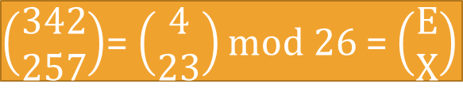
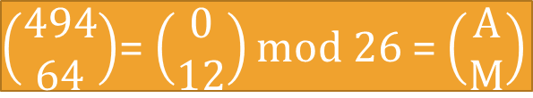
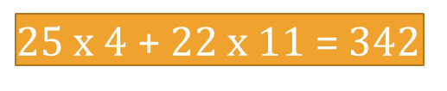
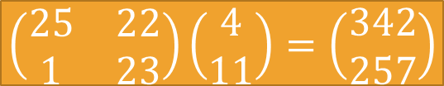
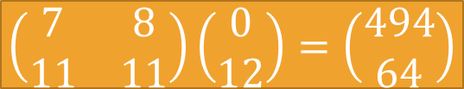
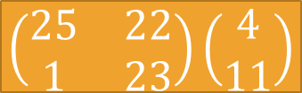
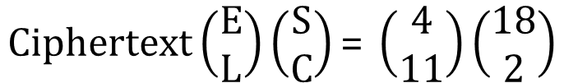
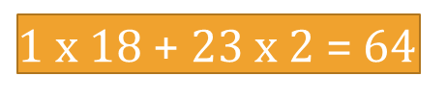
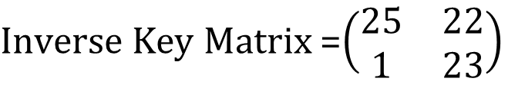
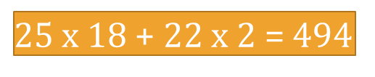
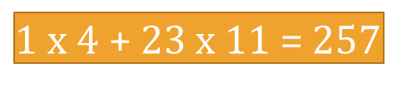
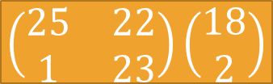
Hill Cipher Encryption (Cont…)
$Inverse Key Matrix$=$\left(\begin{matrix}25 & 22 \\ 1 & 23\end{matrix}\right)$
$$Ciphertext\left(\begin{matrix}E \\ L\end{matrix}\right)\left(\begin{matrix}S \\ C\end{matrix}\right)\text{= }\left(\begin{matrix}4 \\ 11\end{matrix}\right)\left(\begin{matrix}18 \\ 2\end{matrix}\right)$$
  P=CK⁻¹ mod 26
$$\left(\begin{matrix}25 & 22 \\ 1 & 23\end{matrix}\right)\left(\begin{matrix}4 \\ 11\end{matrix}\right)$$
$$\left(\begin{matrix}25 & 22 \\ 1 & 23\end{matrix}\right)\left(\begin{matrix}18 \\ 2\end{matrix}\right)$$
$25$ x 4 + 22 x 11 = 342
$25$ x 18 + 22 x 2 = 494
$1$ x 4 + 23 x 11 = 257
$1$ x 18 + 23 x 2 = 64
$$\left(\begin{matrix}25 & 22 \\ 1 & 23\end{matrix}\right)\left(\begin{matrix}4 \\ 11\end{matrix}\right)=\left(\begin{matrix}342 \\ 257\end{matrix}\right)$$
$$\left(\begin{matrix}7 & 8 \\ 11 & 11\end{matrix}\right)\left(\begin{matrix}0 \\ 12\end{matrix}\right)=\left(\begin{matrix}494 \\ 64\end{matrix}\right)$$
$\left(\begin{matrix}342 \\ 257\end{matrix}\right)$= $\left(\begin{matrix}4 \\ 23\end{matrix}\right)$ mod 26 = $\left(\begin{matrix}E \\ X\end{matrix}\right)$
$\left(\begin{matrix}494 \\ 64\end{matrix}\right)$= $\left(\begin{matrix}0 \\ 12\end{matrix}\right)$ mod 26 = $\left(\begin{matrix}A \\ M\end{matrix}\right)$
Plaintext = “EXAM”

Slide 56
Hill Cipher Examples
Key: Hill Plaintext: short example
Ciphertext: APADJ TFTWLFJ
Key: ACBA Plaintext: DR GREER ROCKS (A=1, B=2, … )
Ciphertext: FZIFTOTBXGPO
Key:DACB Ciphertext: SAKNOXAOJ (A=1,B=2,…)
            Plaintext: WELOVEMATH

Slide 57
Substitution Techniques
  Caesar Cipher
  Monoalphabetic Cipher
  Playfair Cipher
  Hill Cipher
  Polyalphabetic Ciphers
  One-Time Pad

Slide 58
Polyalphabetic Cipher
Monoalphabetic cipher encoded using only one fixed alphabet
Polyalphabetic cipher is a substitution cipher in which the cipher alphabet for the plain alphabet may be different at different places during the encryption process.
  Vigenere cipher
  Vernam cipher

Slide 59
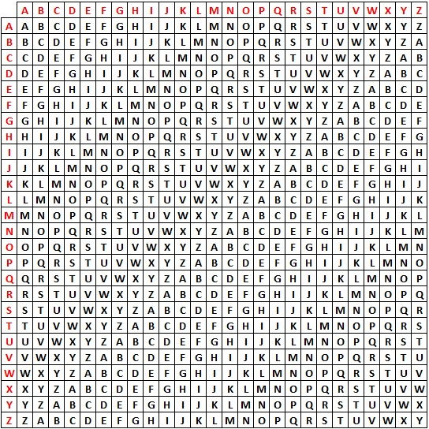
Plaintext
Key
PT = HELLO
KEY = GMGMG
CT = NQRXU

Slide 60
Vigenere Cipher
  Keyword : DECEPTIVE
  Key : DECEPTIVEDECEPTIVEDECEPTIVE
  Plaintext : WEAREDISCOVEREDSAVEYOURSELF
  Ciphertext : ZICVTWQNGRZGVTWAVZHCQYGLMGJ
Key must be as long as plaintext else repeat a keyword
$$C= \left(P_{1}+K_{1},P_{2}+K_{2}, …P_{m}+K_{m}\right)mod 26$$
$$P= \left(C_{1}−K_{1},C_{2}−K_{2}, …C_{m}−K_{m}\right)mod 26$$
An analyst looking at only the ciphertext would detect the repeated sequences VTW at a displacement of 9 and make the assumption that the keyword is either three or nine letters in length.
This system is referred as an auto key system
  Keyword : DECEPTIVE
  Key : DECEPTIVEWEAREDISCOVEREDSAV
  Plaintext : WEAREDISCOVEREDSAVEYOURSELF

Slide 61
Vigenere Cipher
Multiple ciphertext letters for each plaintext letter.
Weakness is repeating, structured keyword.
Example:
Plaintext: internet technologies
Key: cryptography
Cipher using standard algorithm:
Cipher using auto key system:
kertkbkk ttjfpfjdzm
kertkbkk ttjfvbesxl

Slide 62
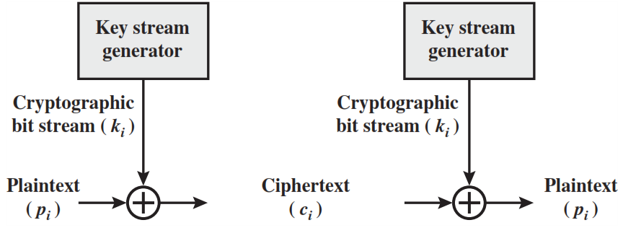
Vernam Cipher
The ciphertext is generated by applying the logical XOR operation to the individual bits of plaintext and the key stream.

Slide 63
Substitution Techniques
  Caesar Cipher
  Monoalphabetic Cipher
  Playfair Cipher
  Hill Cipher
  Polyalphabetic Ciphers
  One-Time Pad

Slide 64
One time pad
Similar to Vigenere, but use random key as long as plaintext.
Only known scheme that is unbreakable (unconditional security)
  Ciphertext has no statistical relationship with plaintext.
  Given two potential plaintext messages, attacker cannot identify the correct message.
Two practical limitations:
  Diﬃcult to provide large number of random keys
  Distributing unique long random keys is diﬃcult

Slide 65
One time pad
Attacker knows the ciphertext:
ANKYODKYUREPFJBYOJDSPLREYIUNOFDOIUERFPLUYTS
Attacker tries all possible keys.
Two examples:
key1: pxlmvmsydofuyrvzwctnlebnecvgdupahfzzlmnyih
Plaintext1: mr mustard with the candlestick in the hall
key2: mfugpmiydgaxgoufhklllmhsqdqogtewbqfgyovuhwt
Plaintext2: miss scarlet with the knife in the library
There are many other legible plaintexts obtained with other keys. No way for attacker to know the correct plaintext

Slide 66
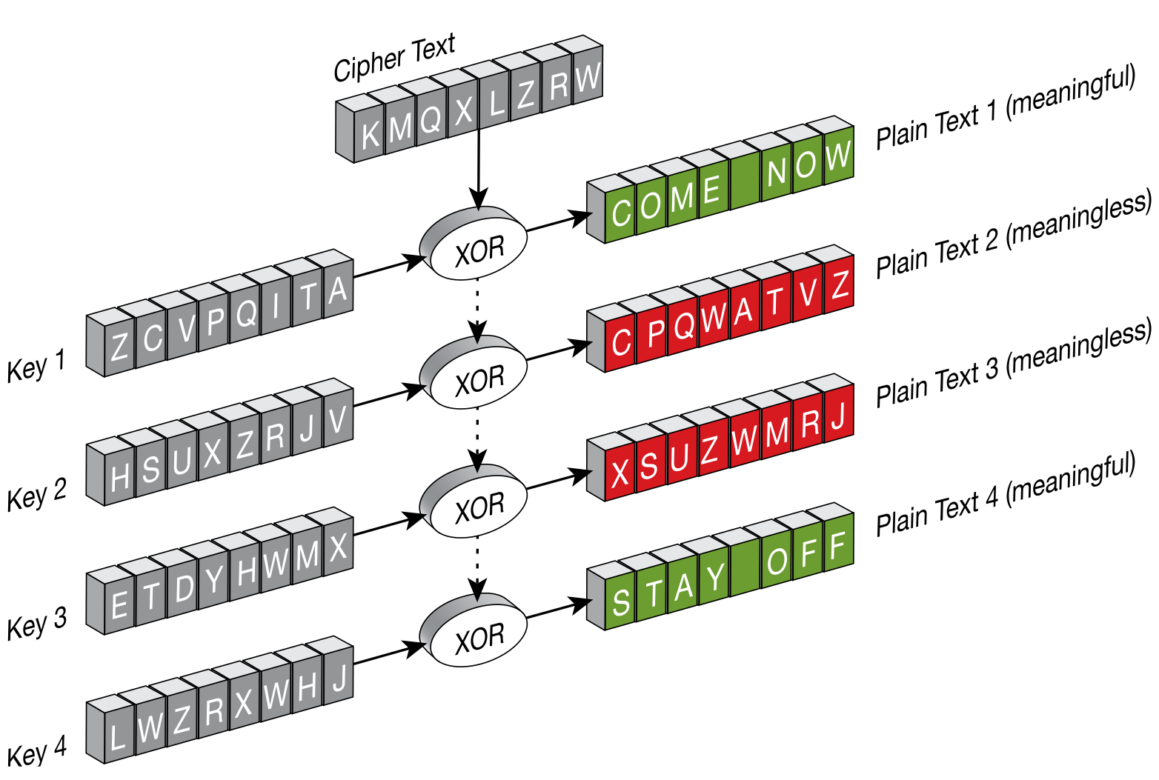

Slide 67
Classical Encryption Techniques
Classified in two categories:
Substitution Techniques
[Letters are replaced by other letters]
  Caesar Cipher
  Monoalphabetic Cipher
  Playfair Cipher
  Hill Cipher
  Polyalphabetic Ciphers
  One-Time Pad
Transposition Techniques
[Letters are rearranged]
  1. Rail Fence
  2. Columnar

Slide 68
Transposition Techniques
A transposition cipher does not substitute one symbol for another, instead it changes the location of the symbols.
The simplest such cipher is the rail fence technique, in which the plaintext is written down as a sequence of diagonals and then read off as a sequence of rows.
For example, to send the message “Meet me at the park” to Bob, Alice writes
M
E
M
A
T
E
A
K
She then creates the ciphertext:
E
T
E
T
H
P
R
MEMATEAK
ETETHPR

Slide 69
Rail Fence Transposition
Easy to break: letter frequency analysis to determine depth.
Example:
Plaintext: internettechnology
Depth: 3
Cipher:
IRTNGNENTEHOOYTECL
I |  |  |  | R |  |  |  | T |  |  |  | N |  |  |  | G
 | N |  | E |  | N |  | T |  | E |  | H |  | O |  | O |  | Y
 |  | T |  |  |  | E |  |  |  | C |  |  |  | L

Slide 70
Rail Fence Transposition - Example
Question: Apply encryption and decryption on the data ‘cryptography’ using rail fence cipher. Show the steps.
Encryption:
Plaintext: cryptography
Depth: 2 [if not mentioned][default]
Ciphertext: ?
Step 1: Write the plaintext column-wise
Step 2: Write the data row-wise = ciphertext
Ciphertext = cytgahrporpy
c |  | y |  | t |  | g |  | a |  | h
 | r |  | p |  | o |  | r |  | p |  | y

Slide 71
Rail Fence Transposition - Example
Question: Apply encryption and decryption on the data ‘cryptography’ using rail fence cipher. Show the steps.
Decryption:
Ciphertext: cytgahrporpy
Depth: 2 [if not mentioned][default][Divide the CT into 2 parts]
Plaintext: ?
Step 1: Write the ciphertext row-wise
OR
Step 2: Write the data column-wise = plaintext
Ciphertext = cryptography
c |  | y |  | t |  | g |  | a |  | h
 | r |  | p |  | o |  | r |  | p |  | y
c | y | t | g | a | h
r | p | o | r | p | y

Slide 72
Rows/Columns Transposition
Plaintext letters written in rows.
Ciphertext obtained by reading column-by-column, but rearranged.
Key determines order of columns to read.
Easy to break using letter frequency (try diﬀerent column orders)
  Key: 4 3 1 2 5 6 7
  Plaintext: A T T A C K P
  O S T P O N E
  D U N T I L T
  W O A M X Y Z
  Ciphertext:
TTNA
APTM
TSUO
AODW
COIX
KNLY
PETZ

Slide 73
Rows/Columns Transposition
Transposition ciphers can be made stronger by using multiple stages of transposition
Plaintext: securityandcryptography
Key: 315624
Ciphertext:
Transpose again using same key:
Ciphertext:
EYYARDOYSTRRICGCAPPUNTH
YYCURRAHEOIPDRPYSGNATCT

Slide 74
Columnar Transposition - Example
Question : Apply encryption and decryption on the data ‘security and cryptography’ with key 315624. Show all the steps.
Encryption:
Plaintext: securityandcryptography
Key: 315624
Ciphertext: ?
Step 1: Prepare matrix having keysize columns.
3 | 1 | 5 | 6 | 2 | 4

Slide 75
Columnar Transposition - Example
Plaintext: securityandcryptography
Key: 315624
Step 2: Write the plaintext row-wise in a matrix.
Step 3: Read the data columnwise in increasing order.
Ciphertext = eyyardoystrricgxcappunth
3 | 1 | 5 | 6 | 2 | 4
s | e | c | u | r | i
t | y | a | n | d | c
r | y | p | t | o | g
r | a | p | h | y | x

Slide 76
Columnar Transposition - Example
Decryption:
Ciphertext: eyyardoystrricgxcappunth
Key: 315624
Plaintext: ?
Step 1: Prepare matrix having keysize columns.
3 | 1 | 5 | 6 | 2 | 4

Slide 77
Columnar Transposition - Example
Ciphertext: eyyardoystrricgxcappunth
Key: 315624
Step 2: Write the ciphertext column-wise in increasing order in a matrix.
Step 3: Read the data rowwise. = plaintext
Plaintext = securityandcryptography
3 | 1 | 5 | 6 | 2 | 4
s | e | c | u | r | i
t | y | a | n | d | c
r | y | p | t | o | g
r | a | p | h | y | x

Slide 78
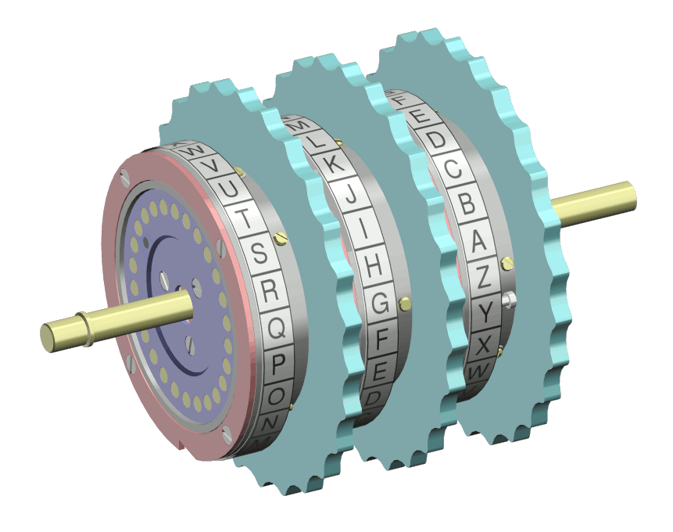
Rotor Machine

Slide 79
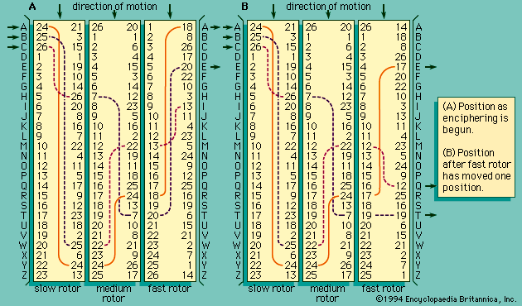
Rotor Machine

Slide 80
Steganography
Character marking: Selected letters of printed or typewritten text are overwritten in pencil. The marks are ordinarily not visible unless the paper is held at an angle to bright light.
Invisible ink: A number of substances can be used for writing but leave no visible trace until heat or some chemical is applied to the paper.
Pin punctures: Small pin punctures on selected letters are ordinarily not visible unless the paper is held up in front of a light.
Typewriter correction ribbon: Used between lines typed with a black ribbon, the results of typing with the correction tape are visible only under a strong light.

Slide 81
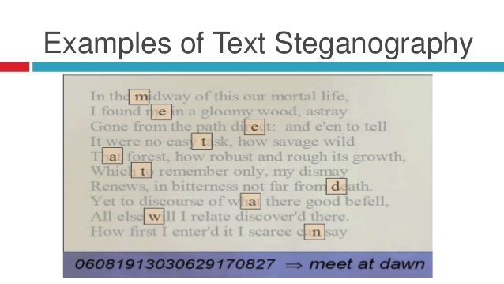
Steganography

Slide 82
Cryptographic Algorithms
Cryptographic algorithms and protocols can be grouped into four main areas
Cryptographic algorithms and protocols
Symmetric encryption
Asymmetric encryption
Data integrity algorithms
Authentication protocols
Data integrity algorithms used to protect blocks of data, such as messages, from alteration.
Authentication Protocols are schemes based on the use of cryptographic algorithms designed to authenticate the identity of entities.
Symmetric encryption used to secure the contents of blocks or streams of data of any size, including messages, files, encryption keys, and passwords
Asymmetric encryption used to conceal small blocks of data, such as encryption keys and hash function values, which are used in digital signatures.

Slide 83
Threat and Attack
Threat: A potential for violation of security, which exists when there is a circumstance, capability, action, or event that could crack security and cause harm. That is, a threat is a possible danger that might exploit a vulnerability.
Attack: An violation on system security that derives from an intelligent threat; that is, an intelligent act that is a calculated attempt to avoid security services and violate the security policy of a system.

Slide 84
Covert Channel
A covert channel is a type of computer attack that allows the communication of information by transferring objects through existing information channels or networks using the structure of the existing medium to convey the data in small parts.
This makes conveyance through a covert channel virtually undetectable by administrators or users.
Covert channels have been used to steal data from highly secure systems.

Slide 85
Sample Questions !!!
Draw model of network security.
Enlist different active attacks. Explain any one of them.
Write a short note on security services.
List out key objectives of Computer Security.
What is covert channel ?
Attacker has interpreted the ciphertext “LJCLQVNROHXDLJW”. He has received one clue which is 10. He thinks that information can be retrieved by using nearby values of clue that he received.
Is playfair cipher considered as a stream cipher? Encrypt the given message using playfair cipher.
Key : spectacular
Message : balloon

Slide 86
Questions !!!
8. Encrypt and decrypt the given message with given key using 6 x 6 playfair cipher.
Key – arvr180 Message – augmentedreallity

